Slide 1


ArcGIS Maps SDK for JavaScript: Web Editing
ESRI DEVELOPER SUMMIT 2023
Heather Gonzago, Tristan Morrison, Jose Banuelos

Slide 2

Slides available: https://links.esri.com/DS23-web-editing

Slide 3

Agenda
Web editing overview
What is it?
Consistency throughout online Apps and App Builders
Editor building blocks
FeatureForm, FeatureTemplates, SketchViewModel, Attachments, SnappingOptions
UI / UX updates from the past year
Tooltips
Asynchronous Arcade Expressions
Preserving data integrity and data precision
Custom editing workflows

Slide 4
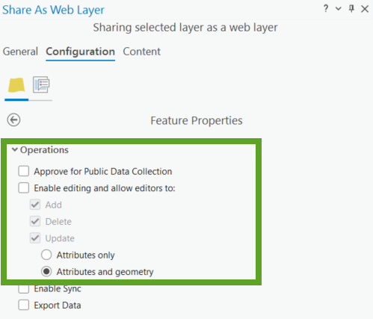
Enable editable data
Share as a Web Layer in Pro

Slide 5
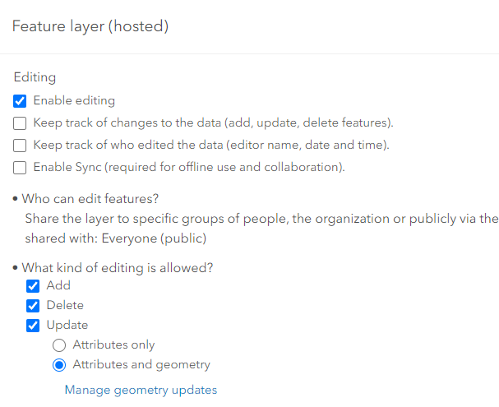
Enable editable data
Enable editing in ArcGIS Online or Enterprise Portal layer item settings

Slide 6
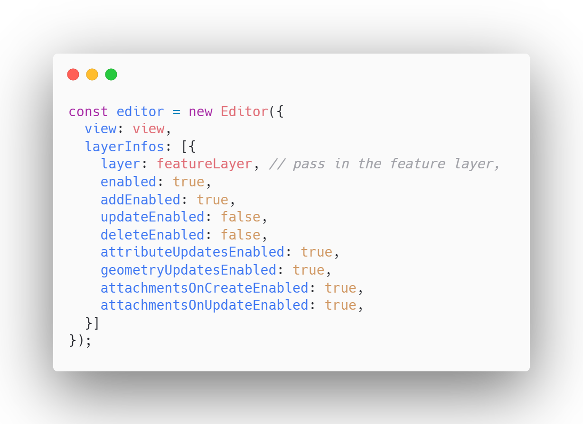
App level configuration
Can restrict editing configurations on the client, if the service supports the operations.
Can restrict attributes or geometry edits for example

Slide 7





Editor building blocks
FeatureTemplates
Editor
Snapping Controls
Attachments

Slide 8
UI / UX Editor improvements
Improved select and create workflows
Removed extra clicks
Help message in Editor footer
Improved UI support for different service editing capabilities
Date and Time now use calcite components
Notes:
New workflows reduces the number of clicks for these workflows

Slide 9
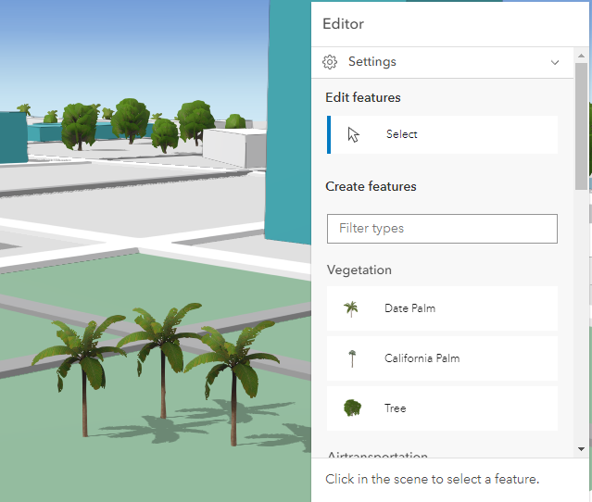
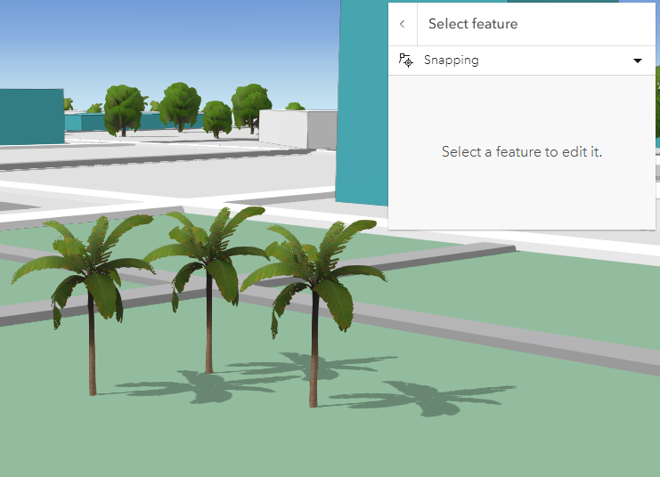
UI / UX Editor improvements
Improved select and create workflows
Removed extra clicks
Help message
Notes:
New workflows reduces the number of clicks for these workflows

Slide 10
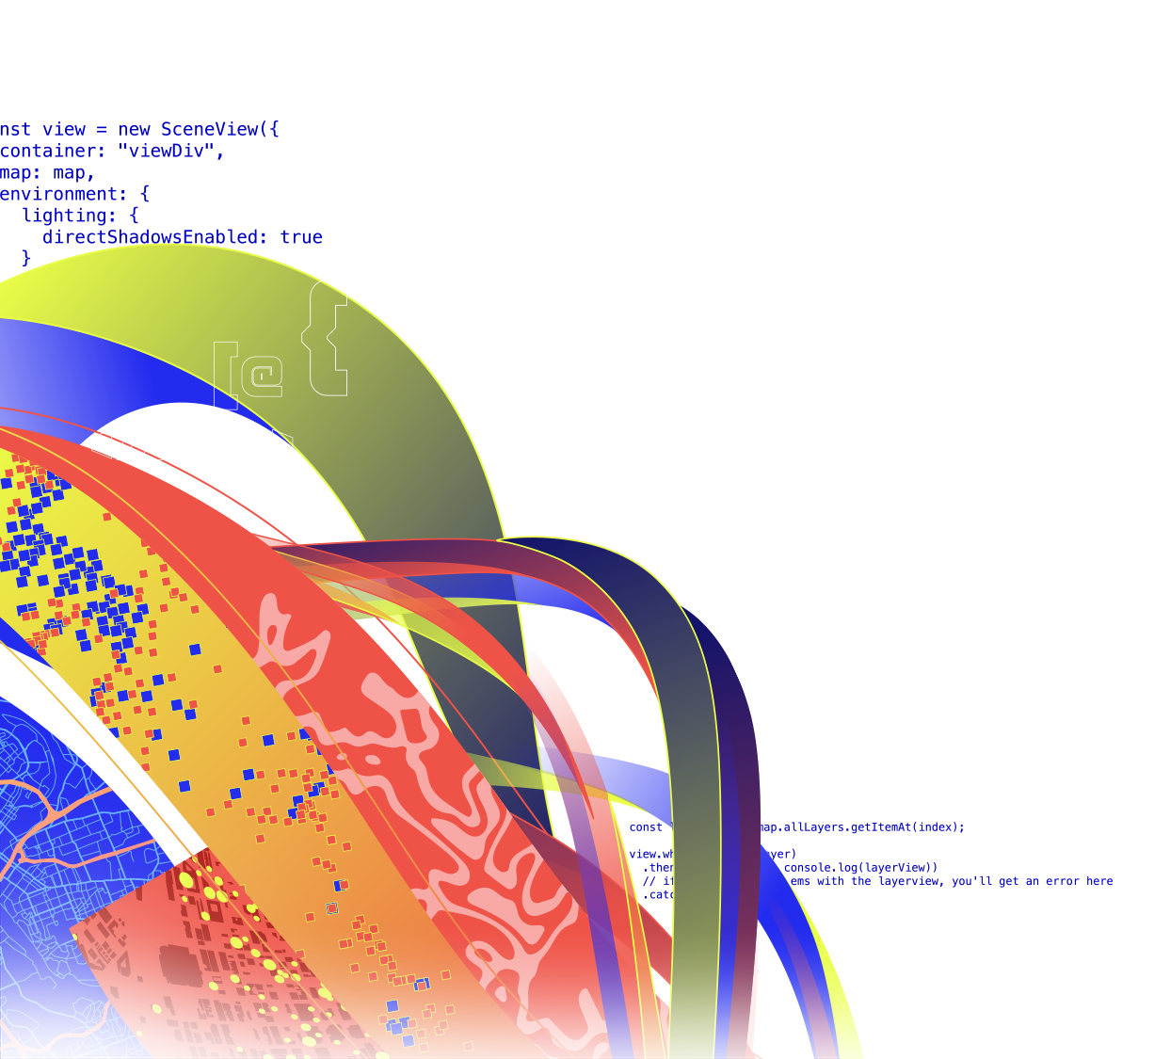
Editor UI Updates

Slide 11
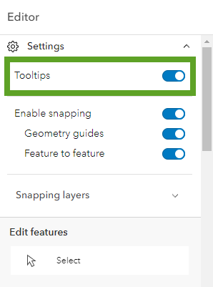
Tooltips
New toggle to enable / disable tooltips
Includes area, length, rotation, orientation, elevation
Supported for both 2D and 3D

Slide 12
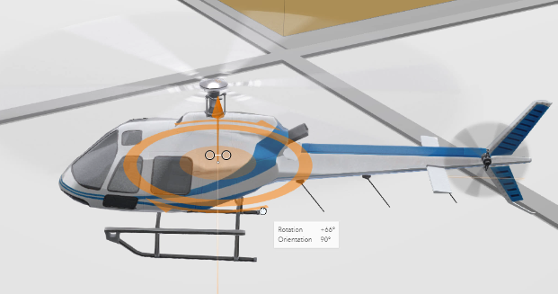
Tooltips
New toggle to enable / disable tooltips
Includes area, length, rotation, orientation, elevation
Supported for both 2D and 3D

Slide 13
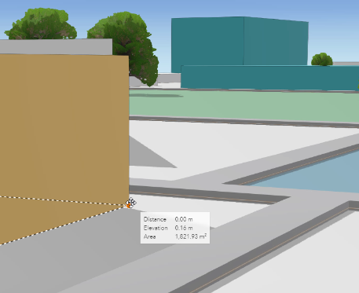
Tooltips
New toggle to enable / disable tooltips
Includes area, length, rotation, orientation, elevation
Supported for both 2D and 3D

Slide 14
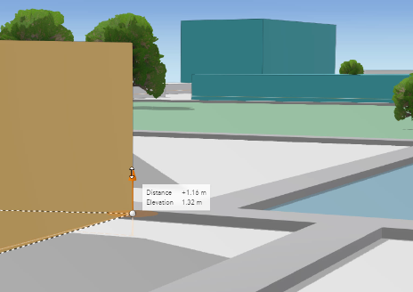
Tooltips
New toggle to enable / disable tooltips
Includes area, length, rotation, orientation, elevation
Supported for both 2D and 3D

Slide 15
Tooltips

Slide 16
UI / UX Editor improvements
Improved UI support for different service and app level editing configurations
Hide Templates if "Adds" operation is disabled on all visible editable layers
Can view attributes when "Update" is disabled
Attachments
Can add attachments on create workflows
Can add / delete attachments when "Update" operation is disabled as long as "Adds" is enabled on the service
Notes:
New workflows reduces the number of clicks for these workflows

Slide 17
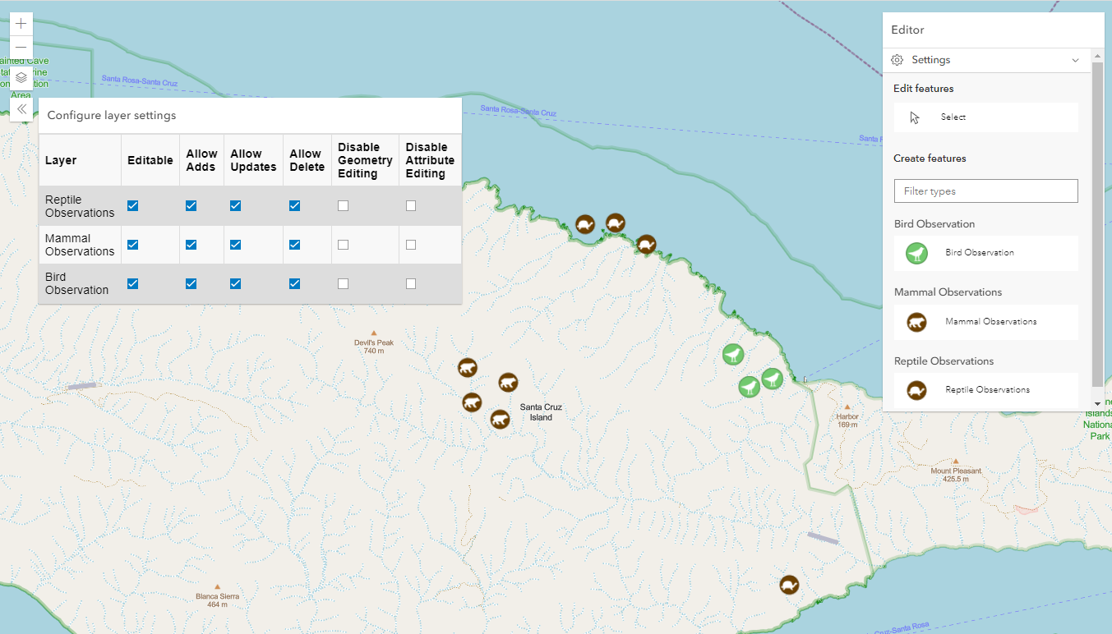
Improved C.R.U.D support

Slide 18
Data Integrity & Arcade Expressions
Tristan Morrison

Slide 19
Preserving Data Integrity
TODO
Contingent Values
Expressions
Required fields
Default values

Slide 20
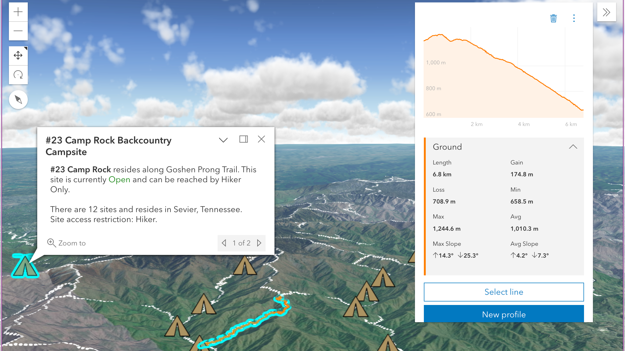
Data Integrity

Slide 21
Asynchronous Arcade Expressions
TODO

Slide 22
Arcade Expressions

Slide 23
Custom Editing Workflows
Heather Gonzago

Slide 24
Custom Editing Workflows
Task-based requirements
Narrows down editing steps for user
Removes unnecessary UI functionality not needed for task
Efficiency and productivity

Slide 25
Custom editing workflows
Editor components
Use with other API components
FeatureTemplates
Snapping Controls
SketchViewModel
Search
Attachments

Slide 26
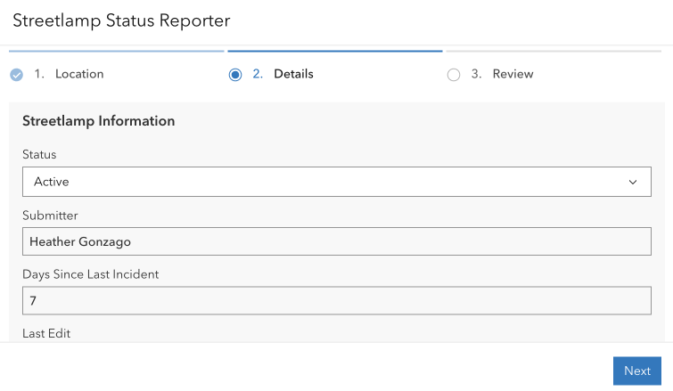
Custom workflows

Slide 27
Consistency throughout Online Apps
All the new features added to Editor widget will be immediately available in the following apps:
MapViewer
SceneViewer
Experience Builder
Instant Apps

Slide 28
Slides available: https://links.esri.com/DS23-web-editing

Slide 29


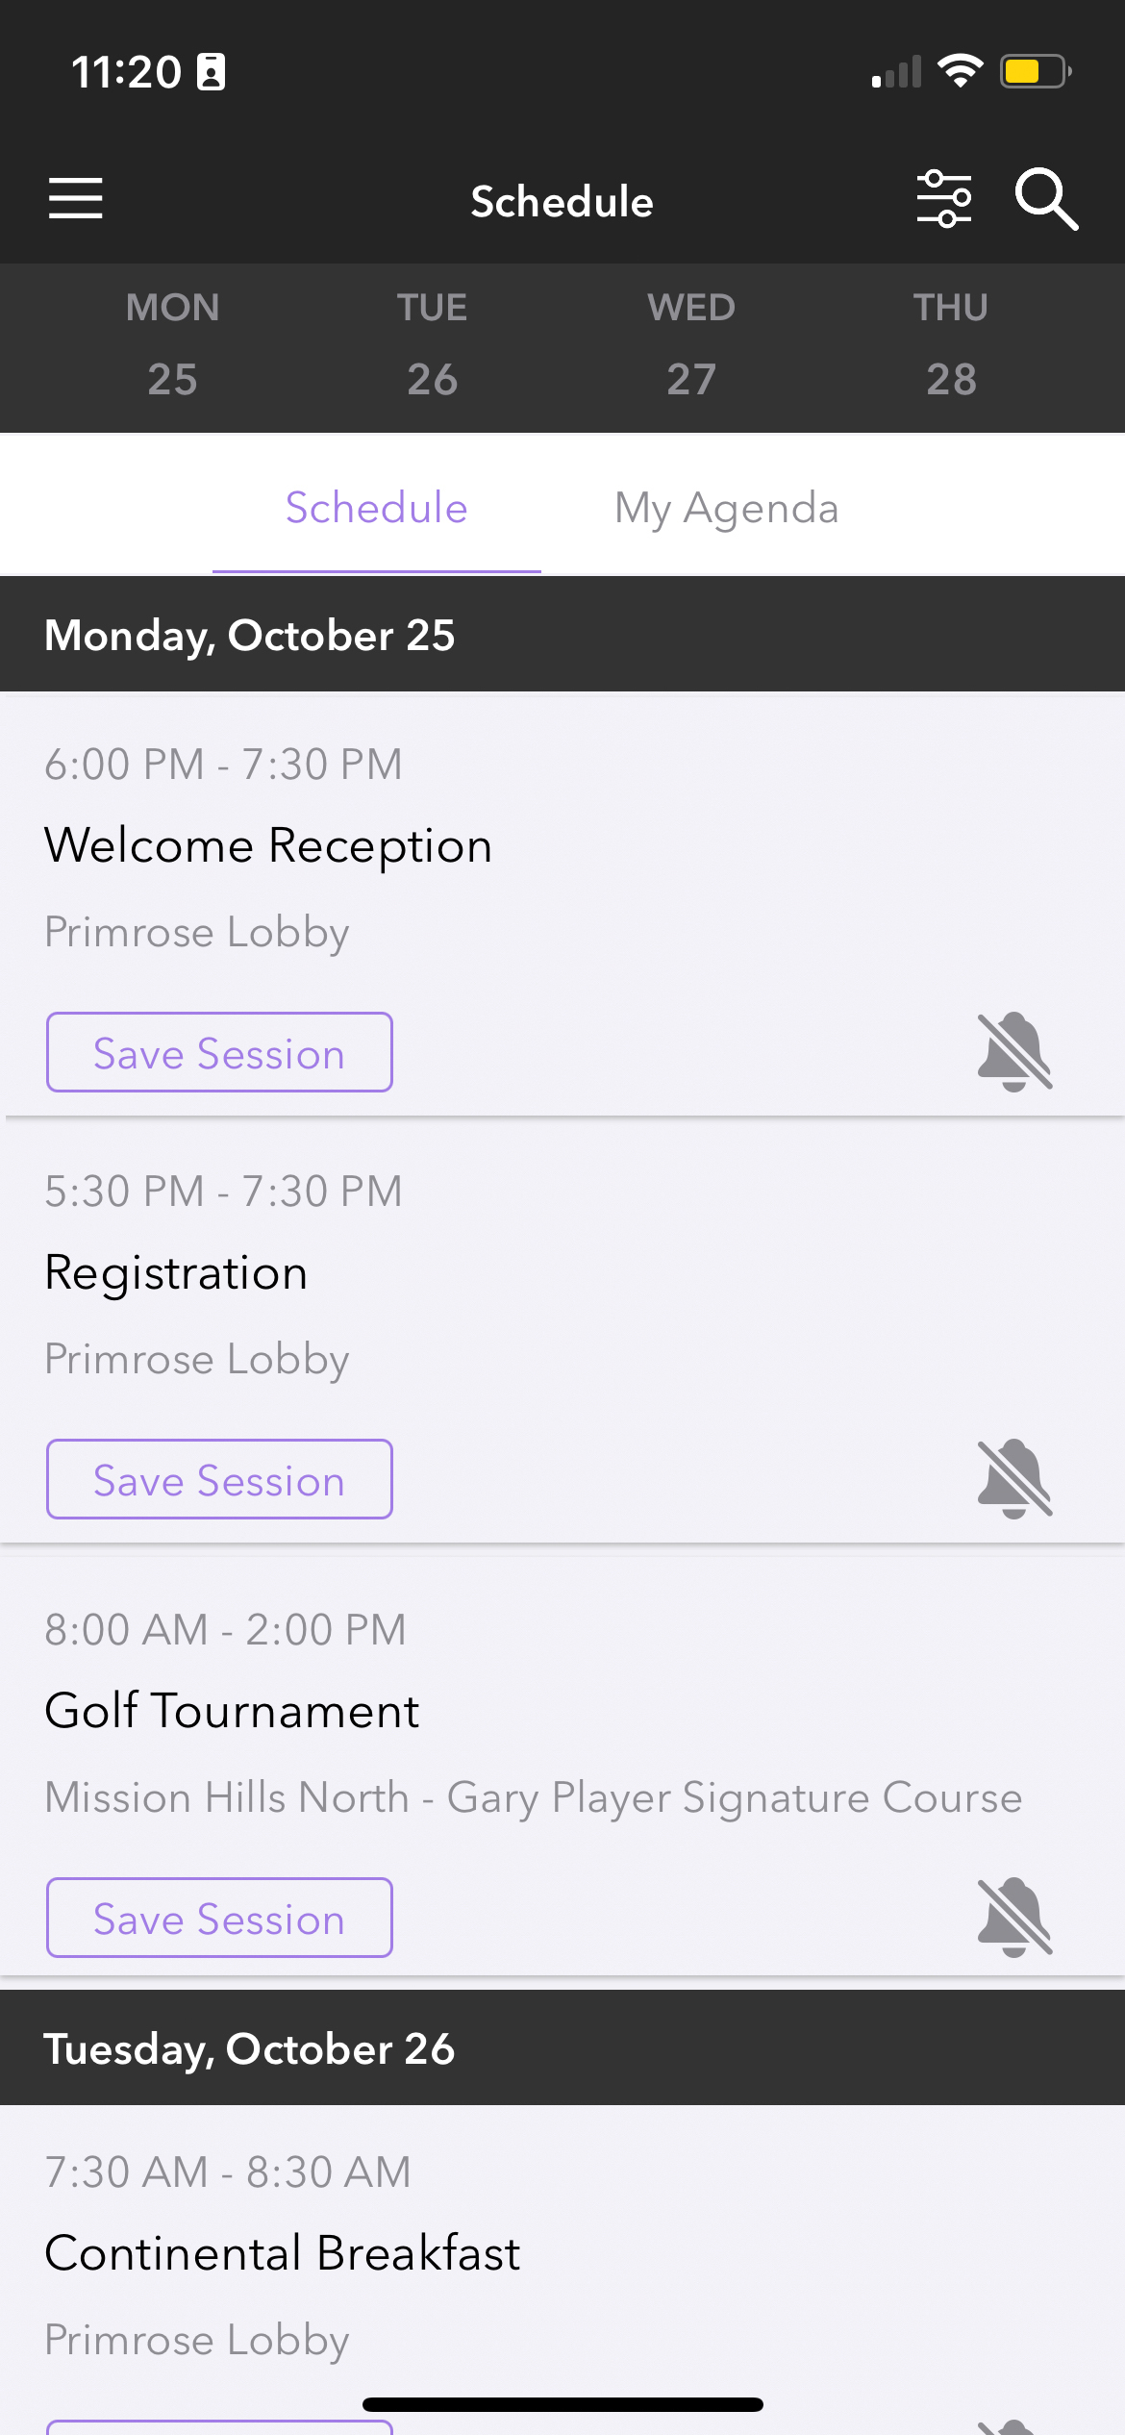
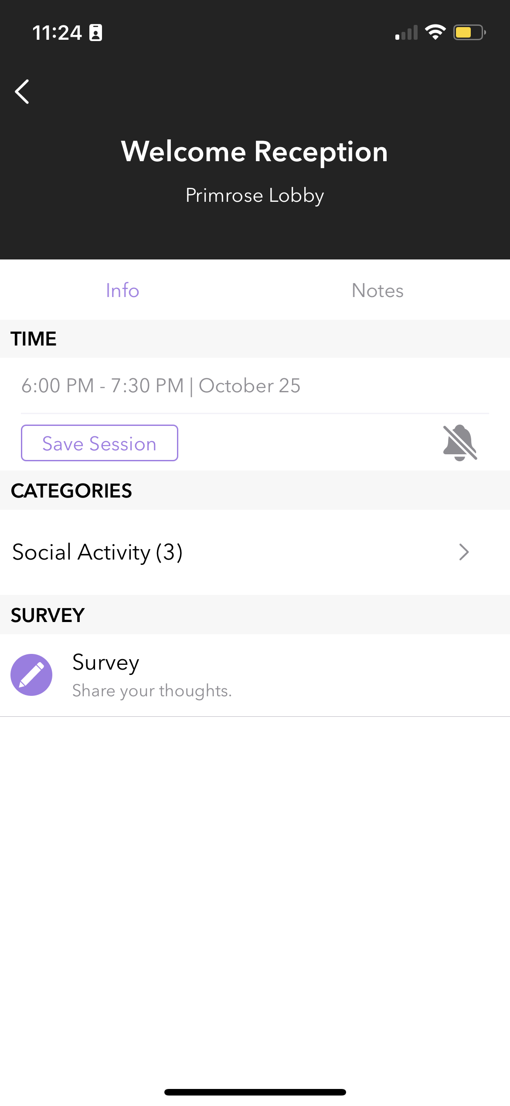
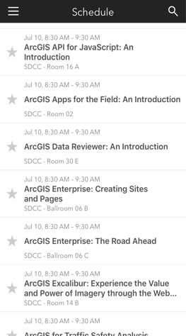
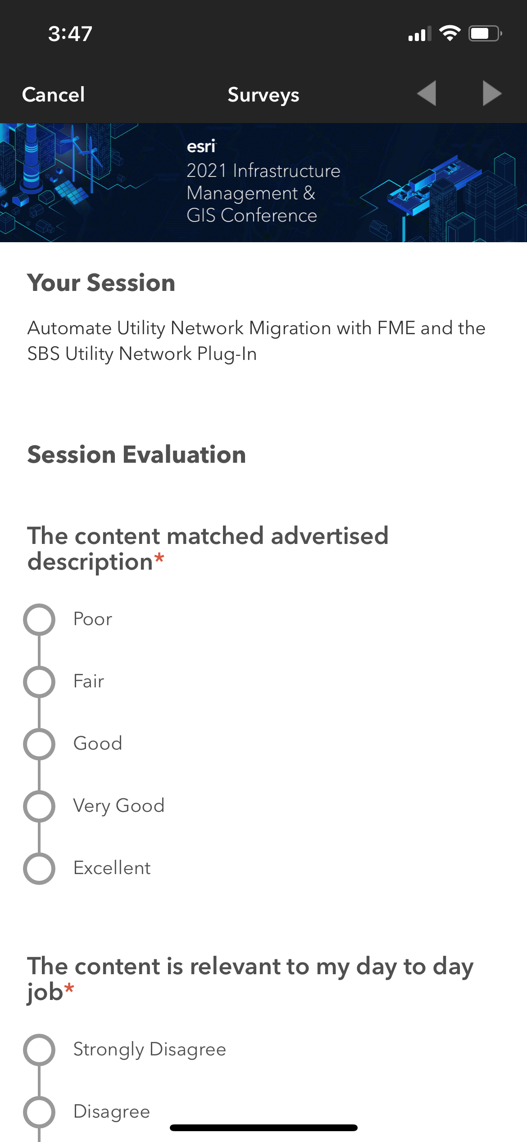
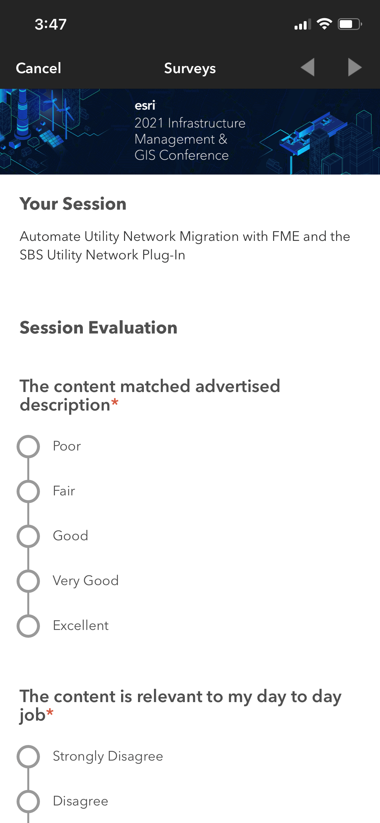

Please Share Your Feedback in the App
Download the Esri Events app and find your event
Select the session you attended
Scroll down to “Survey”
Log in to access the survey

Slide 30





Connect With Us On Social
And Join the Conversation Using #EsriDevSummit
twitter.com/EsriDevs
twitter.com/EsriDevEvents
youtube.com/@EsriDevs
links.esri.com/DevVideos
github.com/Esri
github.com/EsriDevEvents
links.esri.com/EsriDevCommunity
#esridevsummit, #esridevsummit23

Slide 31



Copyright © 2022 Esri. All rights reserved.

